Slide 1


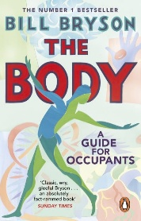
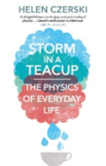
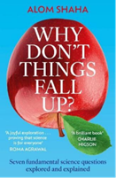
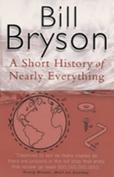
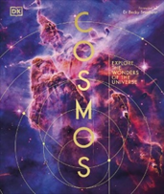


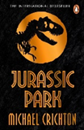
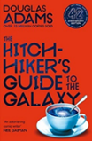


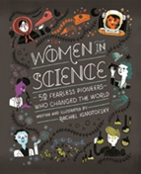

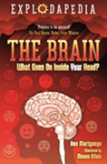
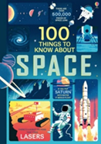


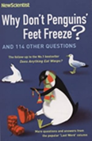

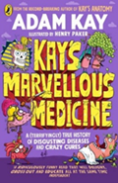
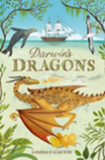
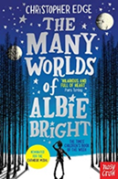
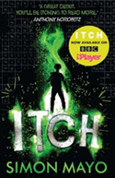
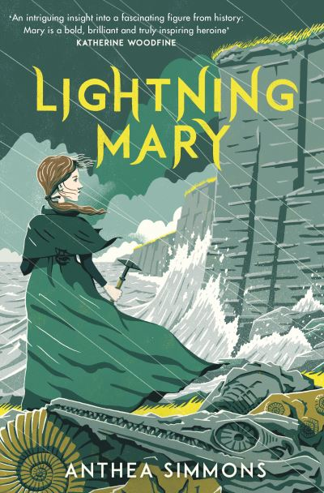
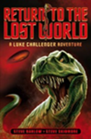


Science Reading Journey
KS4/KS5
The Body
A Guide for Occupants
by Bill Bryson
Storm in a teacup
by Helen Czerski
Why don’t things fall up?
by Adam Shaha
A Short History of Nearly Everything
by Bill Bryson
KS4
Cosmos
by DK
Dry
by Neal Shusterman
Do Androids Dream of Electric Sheep?
by Philip K Dick
Jurassic Park
by Michael Crichton
The Hitch-hiker’s
Guide to
the Galaxy
by Douglas Adams
KS3
This book is
cruelty free
by Linda Newbury
Chris Packham’s
Birdwatching Guide
Women in
Science
by Rachel Ignotofsky
The boy who
harnessed the wind
by William Kamkwamba
The Brain
by Ben Martynoga
KS3
Nonfiction
100 things to
know about space
by Alex Frith
This book is not
rubbish
by Isabel Thomas
Nature is
the answer
by Chris Packham
Why don’t
penguins’ feet
freeze?
by New Scientist
This book will
save the planet
by Dany Sigwalt
Kay’s marvellous
medicine
by Adam Kay
KS3
fiction
Darwin’s Dragons
by Lindsay Galvin
The many worlds
of Albie Bright
by Christopher
Edge
Itch
by Simon Mayo
Lightning Mary
by Anthea Simmons
Return to the
Lost World
by Steve Barlow
The White
Darkness
by Geraldine
McCaughrean

