Slide 1


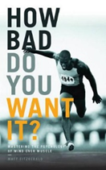

















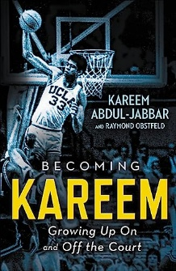



PE Reading Journey
GCSE
How bad do you want it?
by Matt Fitzgerald
Shoe Dog
by Phil Knight
I am a secret footballer
by The Secret Footballer
GCSE
Butterfly
by Yusra Mardini
Never give up
by Bear Grylls
You are awesome
by Matthew Sayed
Year 9
Girls with goals
by Clelia Castro-Malaspina
Football’s greatest moments
by Tom Palmer
Women in sport
by Rachel Ignotofsky
Sports Legends
by Rick Broadbent
Year 8
A selection of sports fiction by various authors
KS3 nonfiction
The Keeper
by Tim Howard
Courage to soar
by Simone Biles
Becoming Kareem
by Kareem Abdul-Jabbar
Life skill guides
by Marcus Rashford

