Slide 1


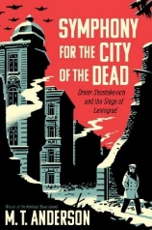

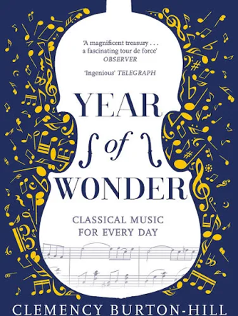
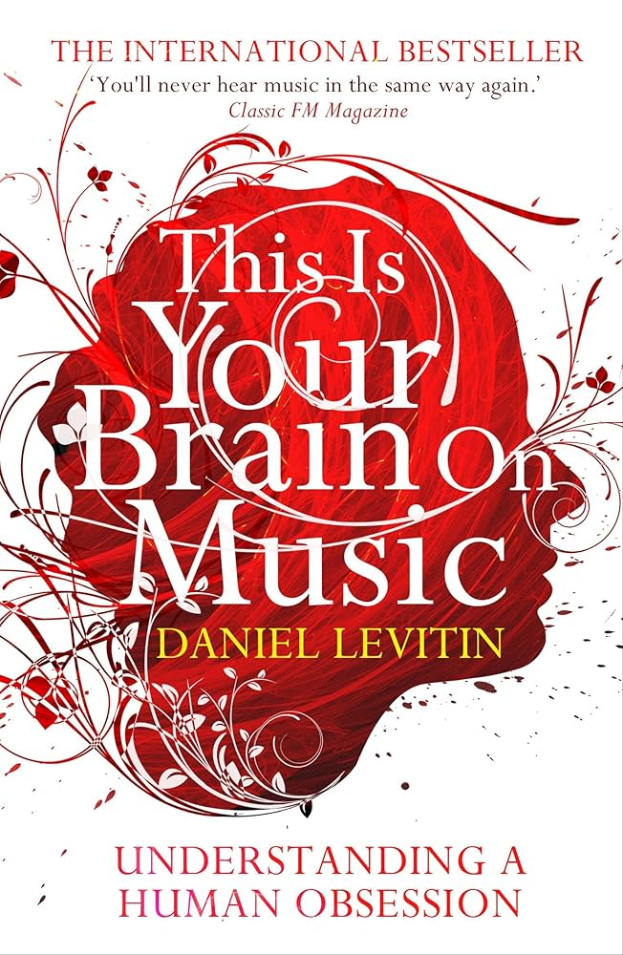
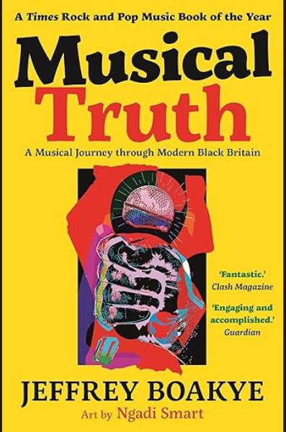




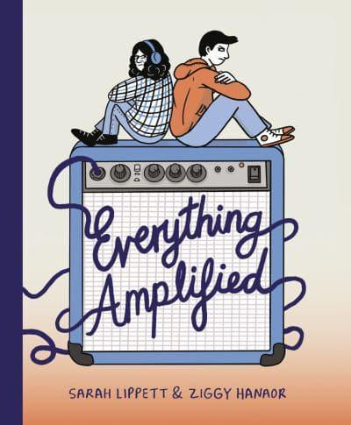


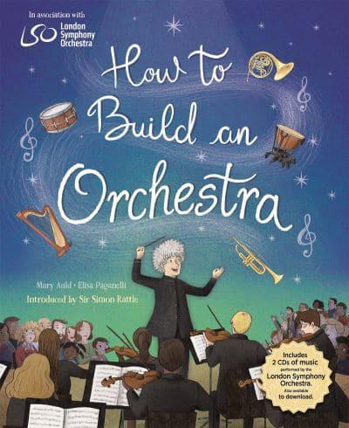
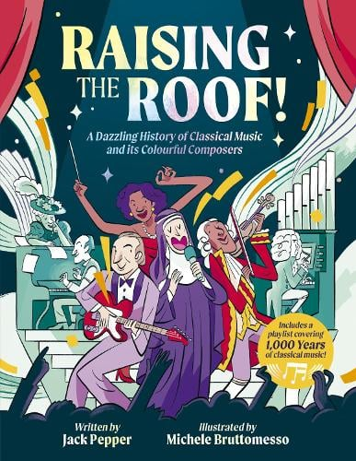
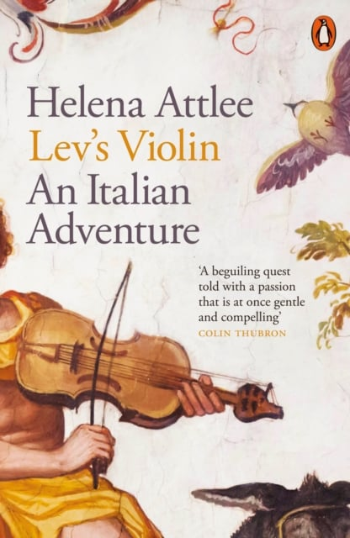



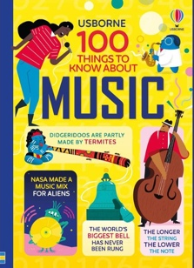
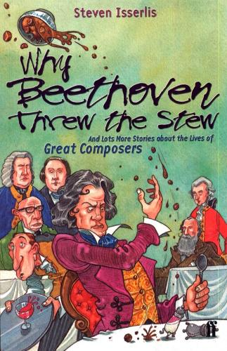

Music Reading Journey
Year 11
Symphony for the City of the Dead
by M.T. Anderson
Big Bangs
by Howard Goodall
Year of Wonder
by Clemency Burton-Hill
This is Your Brain On Music
by Daniel Levitin
Year 10
Musical Truth
by Jeffrey Boakye
The Song Machine
by John Seabrook
The Rest is Noise
by Alex Ross
The Piano Shop on the Left Bank
by T.E. Carhart
Year 9
The Song from Somewhere Else
by A.F. Harrold
Everything Amplified
by Sarah Lippet and Ziggy Hanaor
Young Person’s Guide to Vocal Health
by Olivia Sparkhall
History of Rock for Big Fans and Little Punks
by Rita Nabais
Year 8
How to Build an Orchestra by Mary Auld & The LSO
Raising the Roof
by Jack Pepper
Lev’s Violin
by Helena Attlee
The Music Shop
by Rachel Joyce
Year 7
Rock Band: Music and Misfits
by Leah Osakwe
The Lucy Variations
by Sara Zarr
100 Things to Know About Music
Why Beethoven Threw the Stew
by Steven Isserlis

