Slide 1









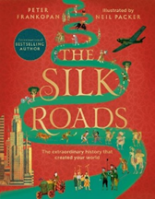









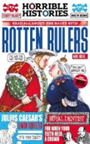

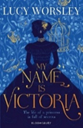


History Reading Journey
GCSE
The Complete Maus
by Art Spiegelmon
Sisters of the East End
by Hellen Batten
Regeneration
by Pat Barker
Villette
by Charlotte Bronte
GCSE
Brilliant Black British History
by Atinuke
Black and British
by David Olusoga
Normal Women
by Philippa Gregory
The Silk Roads
by Professor Peter Frankopan
Year 9
The Diary of a young girl
by Anne Frank
Hardit Singh Malik: World War One
Flying Ace
by Bali Rai
Yellow Star
by Jennifer Roy
Windrush Child
by Benjamin Zephaniah
Year 8
When the world was ours
by Liz Kessler
War stories
by Michael Morpurgo
Stay where you are and then leave
by John Boyne
Black Powder
by Ally Sherrick
Year 7
Horrible Histories series
My Story
series
My name is
Victoria
by Lucy Worsley
Eliza Rose
by Lucy Worsley

