Slide 1


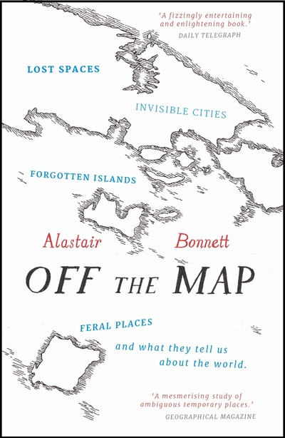
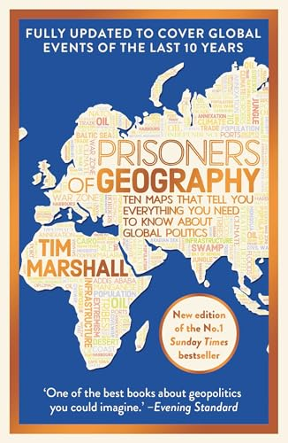
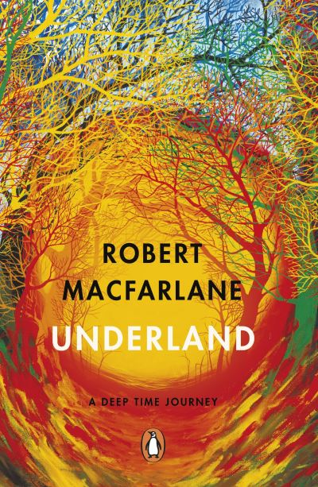
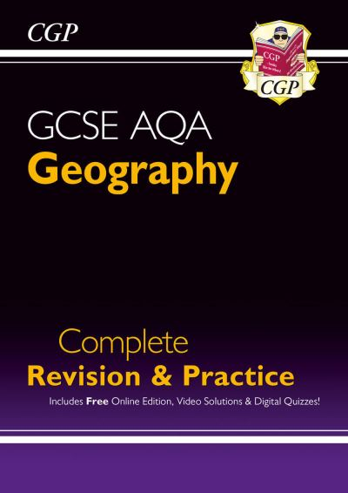

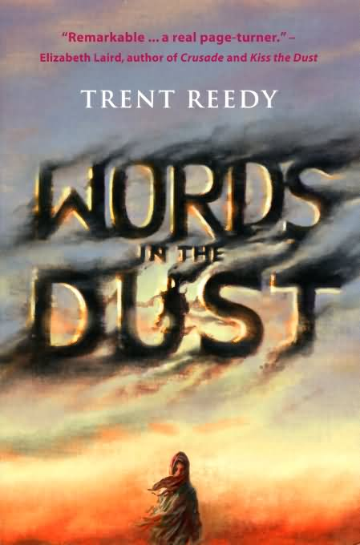
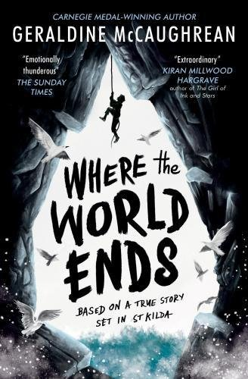





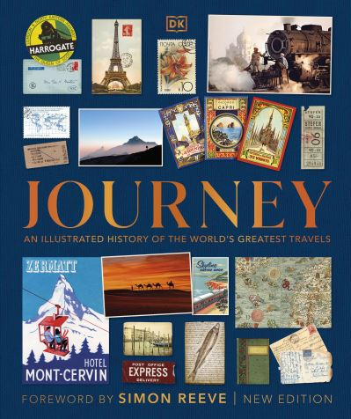



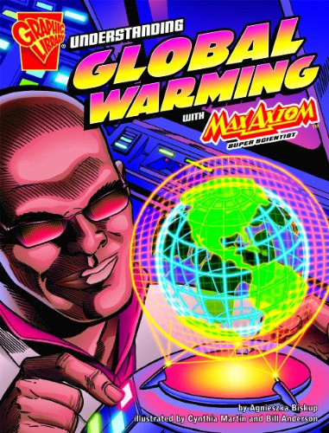
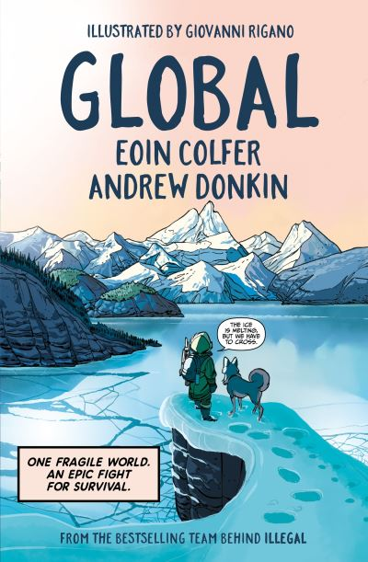




Geography Reading Journey
GCSE
Off the map
by Alastair Bonnett
Prisoners of Geography
by Tim Marshall
Underland
by Robert Macfarlane
Geography revision and practice
by CGP
Year 9
Welcome to Nowhere
by Elizabeth Laird
Words in the Dust
by Trent Reedy
Where the world ends
By Geraldine McCaughrean
In the sea there are crocodiles
by Fabio Geda
Year 8
The White Darkness
by Geraldine McCaughrean
Tsunami Girl
by Julian Sedgwick
Our Planet
by Matt Wyman
Gold of the Gods
by Bear Grylls
Year 7
Journey
by DK
Lion A long way home
by Saroo Brierley
The Travel Book
by Lonely Planet
America Unchained
By Dave Gorman
Year 7
Max Axiom series in the graphic novel section
Global
by Eoin Colfer
Around the world in 80 trains
by Monisha Rajesh
Journeys to impossible places
by Simon Reeve

