Slide 1







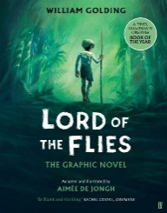








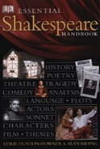





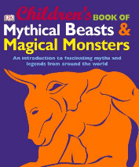



English Reading Journey
GCSE
Far from the Tree
By Robin Benway
Solo
by Kwane Alexander
All my rage
by Sabaa Tahir
Patron Saints of Nothing
by Randy Ribay
Year 9
The Bunker Diary
by Kevin Brooks
Lord of the Flies
by William Golding
Dry
by Neal Shusterman
Floodland
by Marcus Sedgwick
Year 8
The Five
by Hallie Rubenhold
Fleshmarket
by Nicola Morgan
The 57 bus
by Dashka Slater
Ten days a manwoman
by Deborah Noyes
Year 8
The Castle of Otranto
by Horace Walpole
Tales of Mystery and Imagination
by Edgar Allan Poe
Various titles from
The Shakespeare Collection
Plays from the Graphic Novel Collection
Year 7
A selection of myths and legends titles from the Reference Section
by various authors
Fiction titles
by Roma Agrawal

