Slide 1


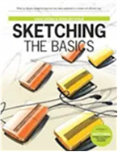
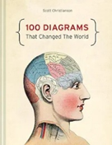

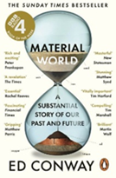
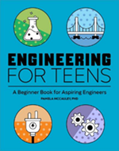
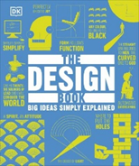
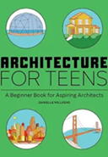
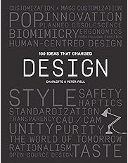


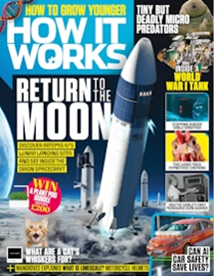
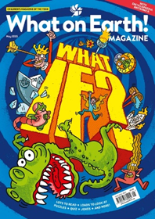


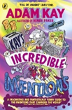




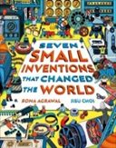

DT Reading Journey
GCSE
Sketching
The Basics
by Koos Eissen
100 Diagrams
That changed the world
by Scott Christianson
I, Robot
by Isaac Astimov
Material World
by Ed Conway
GCSE
Engineering for Teens
by Pamela McCauley
The Design Book
Architecture for Teens
by Danielle S. Willkens
100 ideas that changed design
By Peter Fiell
Year 9
AdelAide just wants
to help
by Melinda Salisbury
The Invention of Hugo Cabret
by Brian Selznick
How it works
Magazine
What on Earth
Magazine
Year 8
The Bletchley Riddle
by Ruta Sepetys
The boy who harnessed the wind
by William Kamkwamba
Incredible Inventions
by Adam Kay
Girls think of everything
by Catherine Thimmesh
Year 7
Harley Hitch
and the Iron Forest
by Vashti Hardy
Alan Turing
by Michael Lee Richardson
Teen Innovators
by Fred Estes
Seven small inventions that changed the world
by Roma Agrawal

