Slide 1


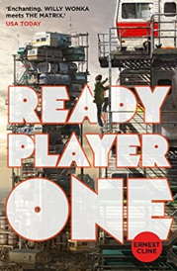

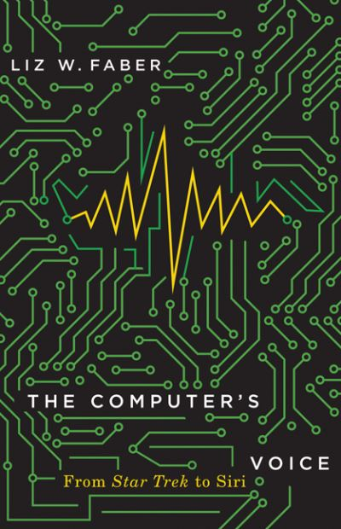
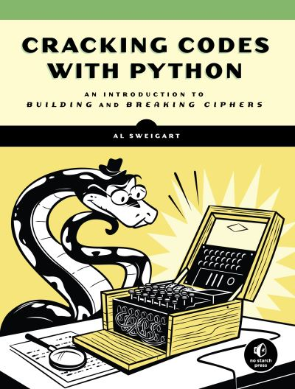

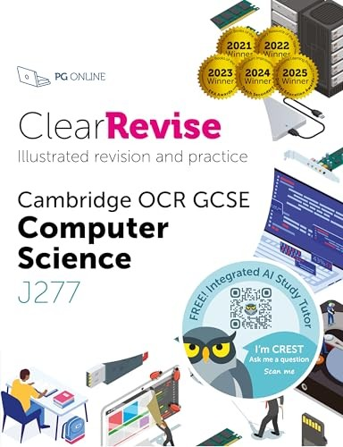
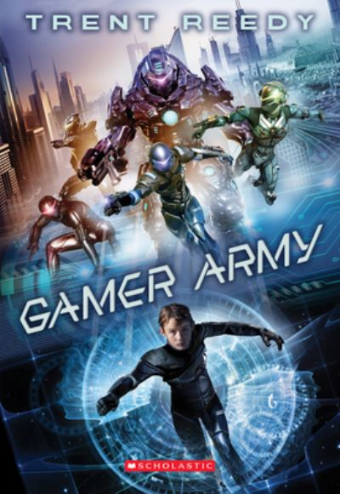
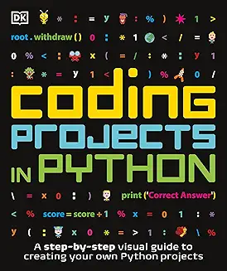

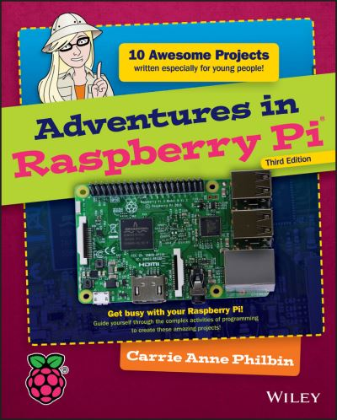
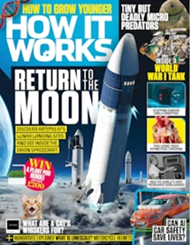
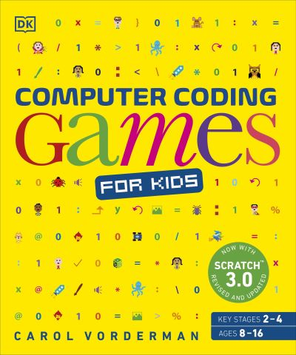




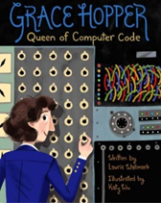
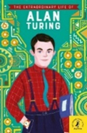


Computer Science
Reading Journey
GCSE
Ready Player One
by Ernest Cline
Daemon
by Daniel Suarez
The computer’s voice
by Liz W. Faber
Cracking Codes with Python
by Al Sweigart
GCSE
I, Robot
by Isaac Astimov
Revision Guide
Gamer Army
by Trent Reedy
Coding projects in Python
by DK
Year 9
The teenage guide to Life Online
by Nicola Morgan
Adventures in Raspberry Pi
by Carrie Anne Philbin
How it works
Magazine
Computer Coding Games
by DK
Year 8
The Bletchley Riddle
by Ruta Sepetys
In the key of code
by Aimee Lucido
Echostar is always listening
by Melinda Salisbury
Cyberspies
by Logan Macx
Year 7
Grace Hopper
Queen of computer code
by Laurie Wallmark
Alan Turing
by Michael Lee Richardson
Lauren ipsum
by Carlos Bueno
The thrilling adventures of Lovelace and Babbage
by Sydney Padua

